Slide 1
Strategies for effective treatment of complex cases
Elizabeth Clark, MA, LPC-S
www.Amarillo-counseling.com

Slide 2
Goals
Understand and conceptualize complex PTS
Identify important considerations for the therapeutic relationship
Identify appropriate staging of treatment for complex cases
Identify appropriate interventions for each stage of treatment

Slide 3

What doesn’t kill you makes you stronger.
True or False?

Slide 4
Understanding brain structure; the triune brain
Thinking Brain
Neocortex/Cortex
Information through thoughts, beliefs, language
Accessible when we feel calm and safe
Capable of long-term planning
Emotional Brain
Limbic/Midbrain
Information through emotions, relationships, and intuition
Accessed when we feel strongly
Sense of time in minutes or hours
Survival Brain
Brainstem
Information through our senses
Accessed in survival mode
Sense of time is in seconds

Slide 5
Polyvagal Theory
Social engagement (Top Down)
  Ventral Vagal
  When here we are within our Window of Tolerance
Fight/Flight (Mobilization)
  Sympathetic Nervous System
  Danger
Freeze/Fold (Immobilization)
  Dorsal Vagal
  Life Threat

Slide 6
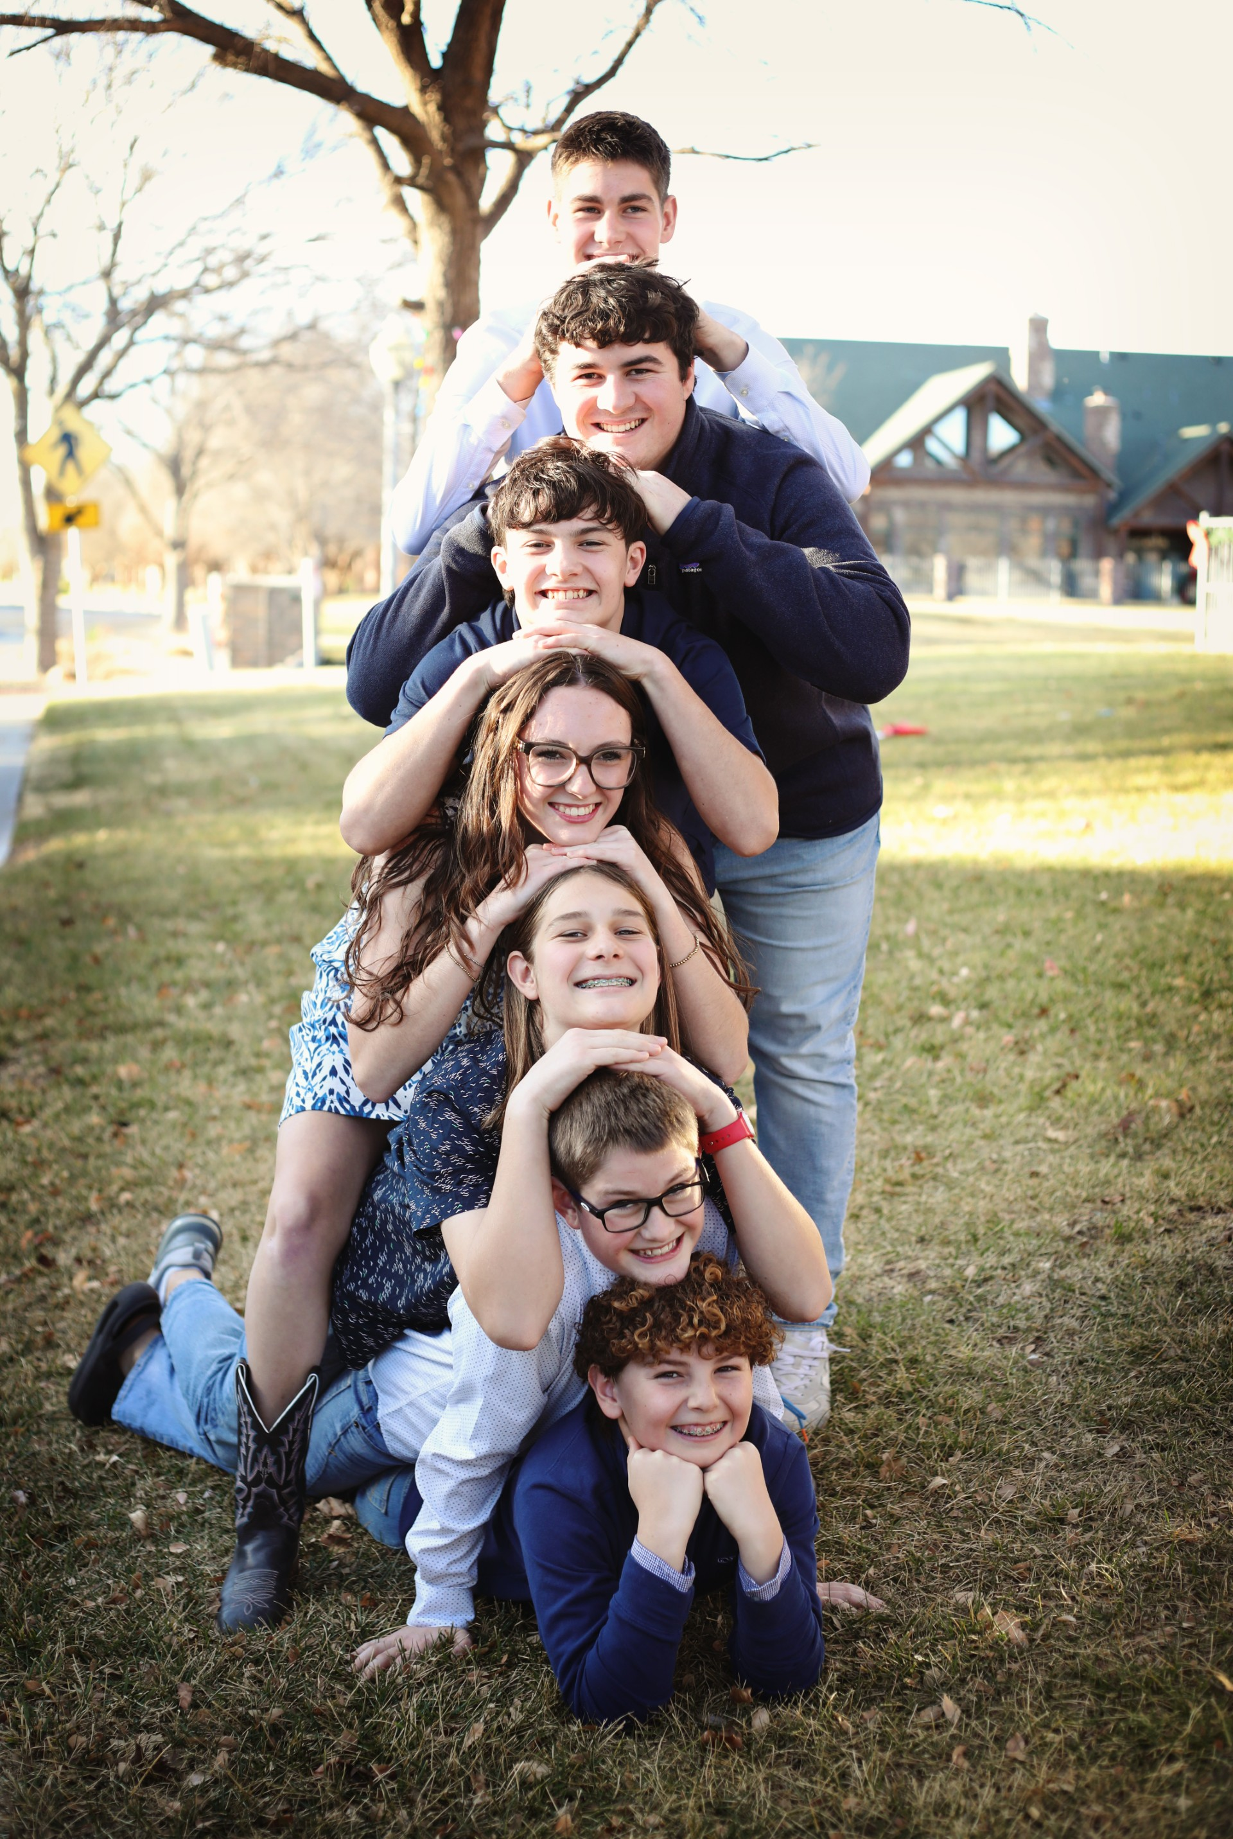
Social Engagement
Our first line of defense against threat
Heart Rate may increase or decrease
Breathing rates may shift up or down
Self-soothing and self regulation (i.e. top-down processing) is accessible which makes it possible for the individual to inhibit sympathetic adrenal influences.
The individual still has access to language and is able to seek support/ask for help
The individual is able to cry and/or grieve
When in our social engagement system, we may feel “bad” but we are still within our window of tolerance.

Slide 7
The Stress Response System
Fight/Flight Response
Adrenaline increases
Heartrate increases
Muscles tense
Blood pressure increases
The body prepares for action
In fight/flight we are able to retain some power.
The goal is to ACT. To CHANGE things or DO something.
Freeze/Fold Response
Heartrate and blood pressure drop
Mind and body disconnect
Avoidance
Compliance
Go Limp/Numb
Common when situation is powerless or there is no escape.
The Goal is to ENDURE

Slide 8
What is trauma?
Trauma is not an event or series of events but our reaction to the event. It is “stuck” processing.
It includes any experience that is overwhelming to the nervous system. It can be acute or complex, individual, transgenerational or cultural. It can have clinical or subclinical presentation.
Vulnerability to trauma is influenced by more than the event itself
  Age- “tree” example
  Support System
  Attachment style
  Intensity and frequency of the stressor or event
  Predictability of the stressor or event
  History of previous trauma
According to the World Health Organization at least 70% of Americans will endure at least one traumatic event in their lifetimes.

Slide 9
A few more considerations. . .
Non-traumatization as a privilege (Baldwin, 2018)
The trauma response is not a character flaw—you can do everything “right” and still suffer from PTS. We are designed to respond in a way that promotes our survival.
Resiliency is not evidence that you are superior, more faithful, “stronger”, etc
Many vulnerability and resiliency factors (such as social support) are out of our direct influence or control
“If knowledge is power, then wisdom is knowing what we don’t know.” Adam Grant

Slide 10

The Compliance Response
Immobilization or an incomplete survival action/response is thought to be at the root of trauma. (Levine, 2010)
The immobilization system is meant to only be engaged for brief periods.
Case Studies:
  “The Raven”, The Boy Raised as a Dog (Perry, 2007)
  Compliance and repeated sexual abuse, APCC case study
Considerations for behavioral and substance addictions
Benefits of “Blaming the victim”?

Slide 11
Complex PTS
Complex PTS can be thought of as trauma that is repeated, cumulative, and often beginning at a young age.
Complex PTS impacts identity formation and attacks the sense of self.
Many who suffer from Complex PTS do not remember life before trauma and therefore may struggle to establish an identity outside of suffering.
  This can lead to ambivalence or secondary gains

Slide 12
Complex Post Traumatic Stress
C-PTSD criteria includes the typical symptoms of PTSD (reexperiencing, avoidance, and persistent perceptions of threat) as well as 3 additional categories of symptoms:
  Affect dysregulation/imbalances in the ANS and PNS
  Negative self-concept
  Interpersonal disturbances
“C-PTSD is associated with the sense that one has lost authority over the process of remembering”
Schwartz (2021)

Slide 13
C-PTSD, Affect Dysregulation
Chronic traumatization results in profound dysregulation of the ANS, which regulates functions such as our heart rate, blood pressure, body temperature, and breathing.
Our ANS will either mobilize energy (SNS) or conserve energy (PNS)
When the ANS is dysregulated, the individual will experience disruption in regulation and affect, which may include chronic hyper or hypo-arousal (fight/flight or freeze).

Slide 14
C-PTSD, Negative Self Concept
Individuals may be prone to an impaired sense of self and struggle to form a coherent sense of self.
Individuals may experience changes to their systems of meaning or core beliefs.
There may be pervasive feelings of shame, guile, and despair.
There may be profound loneliness and despair at the state of the world.
These feelings may interfere with a sense of meaning, hope and purpose.
“I am. . Others are. . The world is. . . So I must. . “

Slide 15
C-PTSD, Interpersonal Disturbances
There may be an inability to develop trusting relationship with others.
There are often ongoing fears of betrayal, abuse, and abandonment.
There may be avoidance and/or over-dependence in relationship.
There may be a hyper-activated caregiving system, which is commonly referred to as codependence.

Slide 16
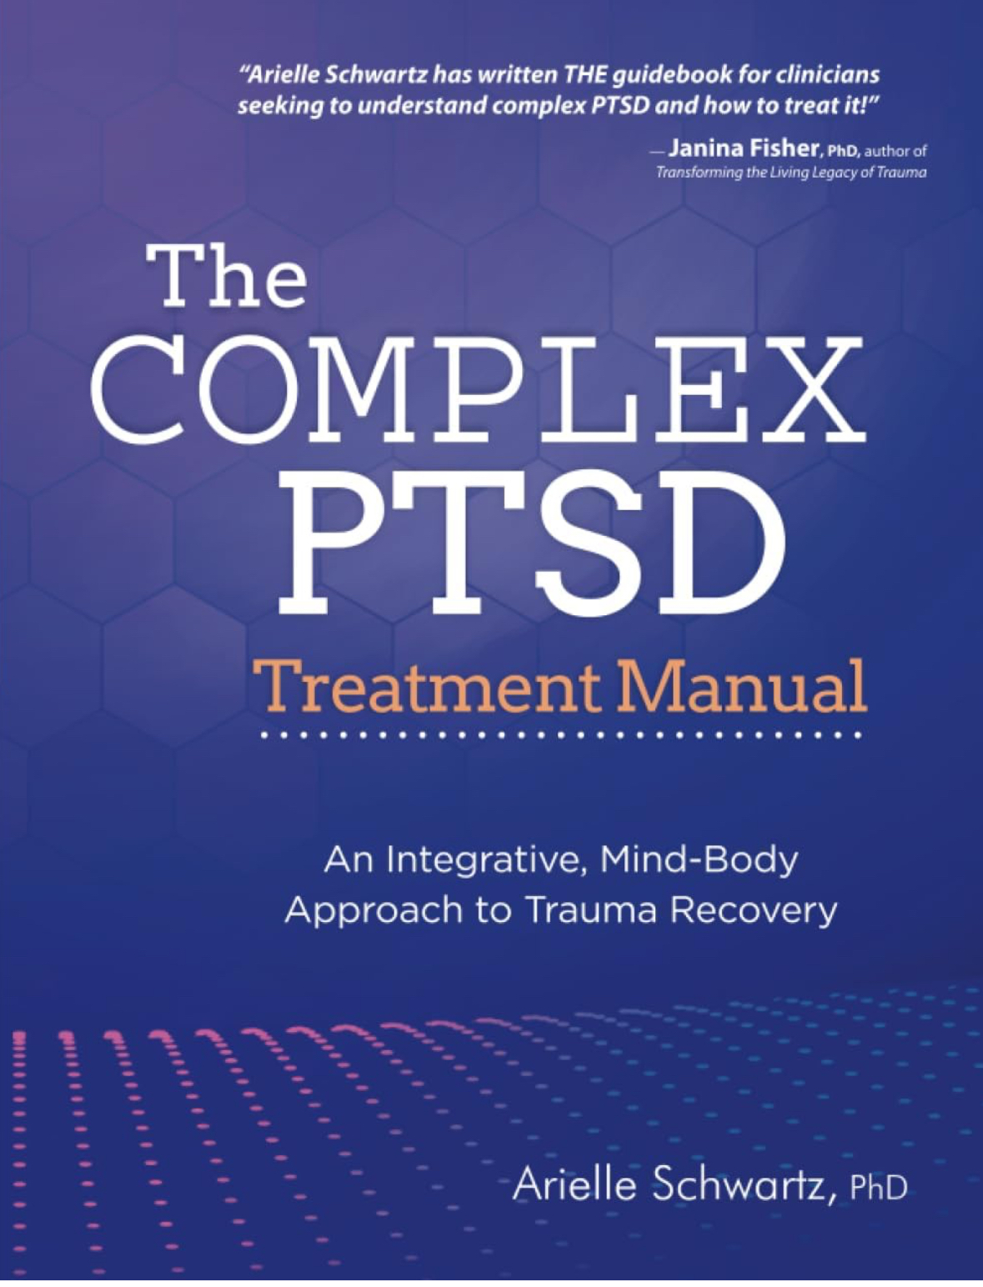
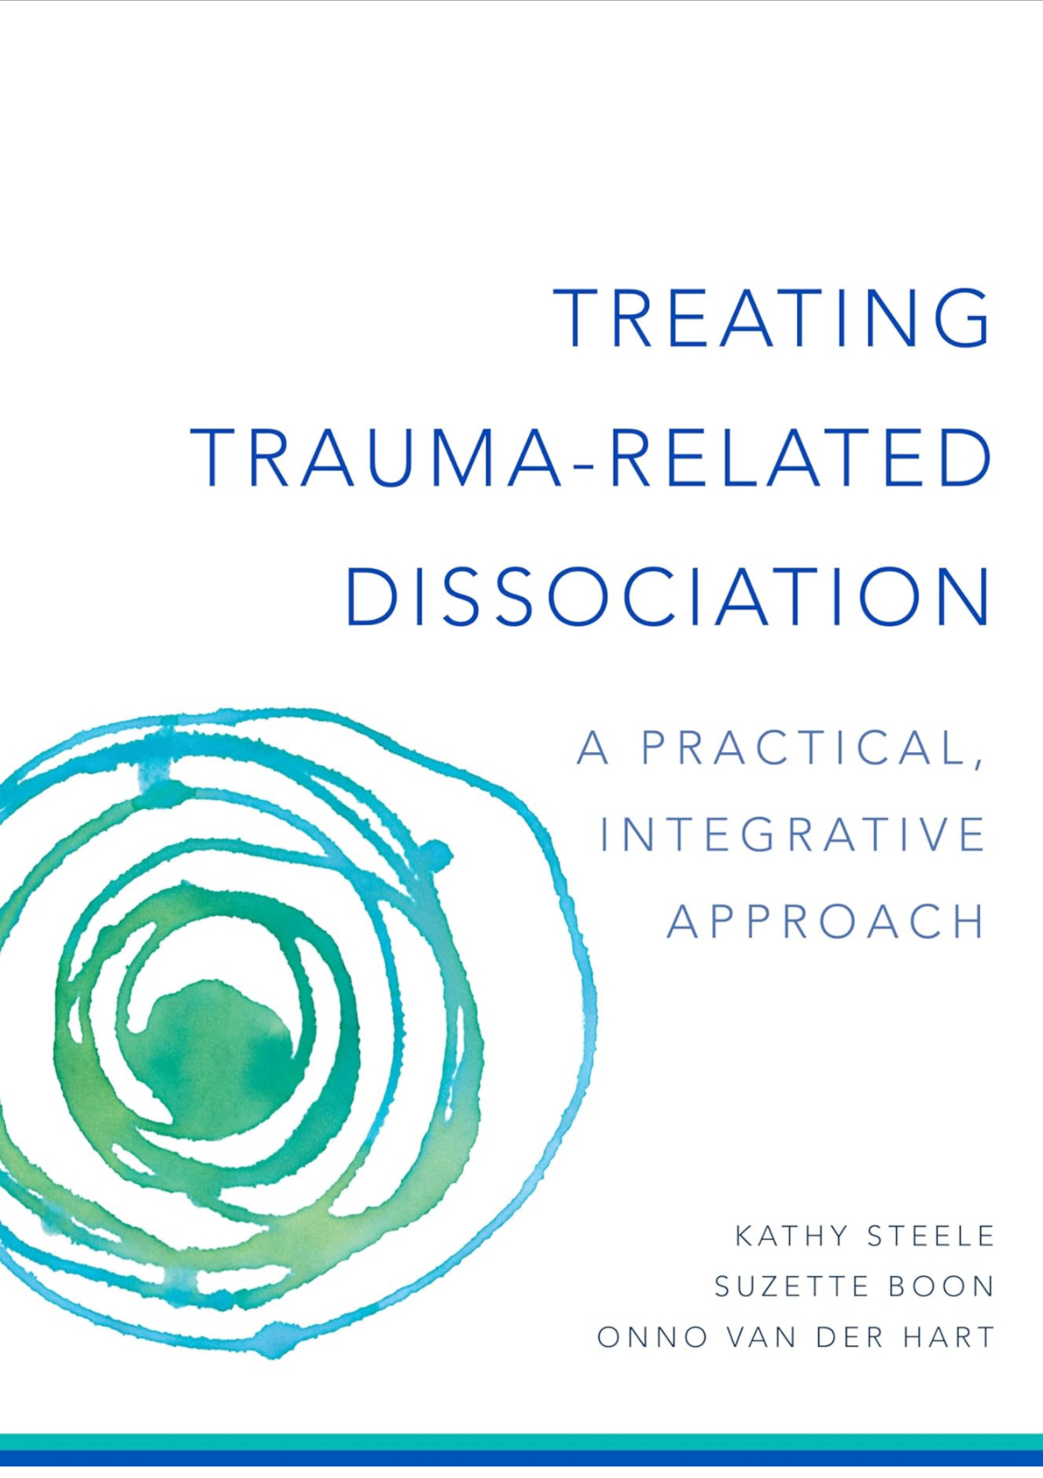

Slide 17
Assessment and Treatment Planning
The professional boards for both Licensed Professional Counselors and Licensed Social Workers requires that we have both an intake assessment and an up-to-date treatment plan.
Why does this matter?

Slide 18
Assessment in C-PTS
What we need to know
  Acute v. complex
  Symptom presentation
  What are the contributing factors for the client’s symptoms?
  What is the client’s support system like?
  Can the client tolerate affect or state change?
  To what degree do we suspect dissociation?
  Are there any possible secondary gains?
  The client’s overall readiness for therapeutic interventions

Slide 19

Objective and subjective measures
PCL-5
DES-II
Life inventory checklist
ACE inventory
Psychosocial interview
Others?

Slide 20
Common Symptoms of Dissociative Disorders
Amnesia
Depersonalization and derealization symptoms that refer to a division of the personality (distorted perception of body, not recognizing self or friends, being ‘outside the body’)
Passive influence (different parts influencing behavior internally)
Somatoform dissociative symptoms (unexplained pain or lack thereof, pseudo-seizures, numbness, conversion disorder)
Schneiderian symptoms (symptoms of schizophrenia)
Puzzling fluctuations in behavior, mood, and narrative
Steele, Boon, and Van der Hart (2017)

Slide 21
False-Positive DID considerations
“Cookbook” answers during diagnostic assessment
Anger/defensiveness when asked for examples of their experience
Clear chronological history
Use of first person across of experiences and third person only when asked about dissociation or parts
Dramatic shifts in the first session or during assessment
Bringing “proof” of DID (timelines, maps or picture of parts)
Reveal diagnosis to many people without fear or shame
Obvious secondary gains.
Heavily involved in DID community or chat rooms.
All clients are suffering and deserving of compassion regardless of presentation.
Steele, Boon, and Van der Hart (2017)

Slide 22
Treatment Planning
Treatment of CPTS MUST be staged appropriately.
Staging helps us ensure that we honor the client’s window of tolerance.
Disclosure is NOT the goal
Abreaction or catharsis is NOT the goal
Ultimately, we aim to reduce symptoms and improve quality of life by establishing both internal and external safety.

Slide 23

Window of Tolerance
The window of tolerance is a term that describes to what degree an individual is able to stay in their social engagement system before their stress response system is activated into fight/flight or freeze.
In order for treatment of C-PTS to be effective we must be aware of our clients’ limitations and tolerance.

Slide 24
Why this matters
Standard protocols do not always work in complex cases and may actually cause harm.
Thoughts? Examples?

Slide 25
Overarching Treatment Goals for C-PTSD
Facilitating greater affect regulation and emotional balance
Reducing avoidance symptoms, including dissociation
Reducing the frequency and intensity of reexperiencing and heightened arousal symptoms
Facilitating improvements in self-concept and sense of self
Enhancing success with interpersonal relationships
Enhancing sense of meaning, purpose, and hope

Slide 26
Staging Treatment
Stage one
Establish safety (including a safe therapeutic relationship), stabilize or reduce symptoms, increase mindful body awareness, increase self-compassion, and introduce parts work therapy.
In dissociative clients this includes realization of present reality.
Stage two
Involves the direct targeting of traumatic memories through exposure and desensitization.
In dissociative clients this includes realization of traumatic memory.
Stage three
Aims to help clients sustain a positive sense of self, strengthen resilience, grieve losses and sustain hope for the future.
Involves facilitation of full realization of past, present, and anticipated future.

Slide 27
Stage One

Slide 28
Stage one goals and objectives
Establish a safe therapeutic relationship.
Increase affect tolerance to widen the “window of tolerance.”
Educate the client on trauma and the stress response system in order to validate their experience and reduce shame.
Connect to and tolerate the body.
Establish collateral contacts, referrals to other professionals, and community support.

Slide 29
Stage one interventions
Identify and practice safe boundaries within the therapeutic relationship
Psychoeducation
Identify and practice multiple regulation activities.
  Regulation scheduling; “back to the basics”
  Mindfulness practice and breath work
    Connection to HRV
  Coping skills of all kinds.
Pendulation and/or titration to increase connection to the body and tolerance for sensation.
Self-compassion work
Parts work
Resourcing
Containment
And many many more. . . .

Slide 30

The Therapeutic Relationship in Complex Cases

Slide 31
The value of the therapeutic relationship
“Safety is the intervention” Porges
Establishing a safe therapeutic relationship is one of the primary tasks of stage one.
CPTS survivors will almost always experience disruption of attachment. Patterns of relationship are likely to be recreated/reenacted within the therapeutic relationship.
Ruptures in the therapeutic relationship are difficult but can be considered opportunity for relearning and healing.

Slide 32
Therapeutic Relationship
We must acknowledge our own experience and patterns of attachment.
“Manipulative behaviors represent efforts to attain safety via caretaking and attachment by the therapist, a legitimate inborn tendency” (Steele, Boon, and Van der Hart, 2017).
It is essential the therapist provide safety before attachment and curiosity and collaboration instead of dependency.
Chronic trauma survivors will often have difficulty managing regulation of closeness and distance and may go between extremes depending on need, defenses, and parts of self.

Slide 33
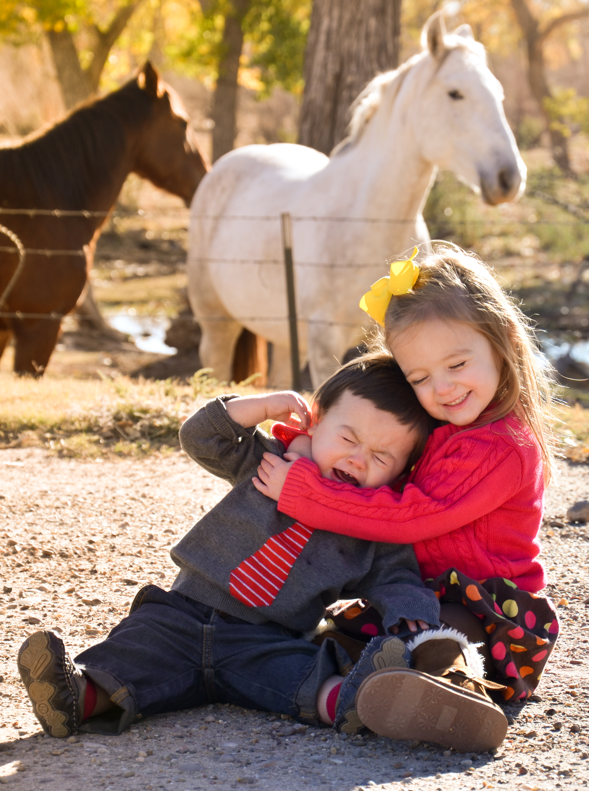
Therapeutic Boundaries
We must carefully consider the boundaries we hold in the therapeutic relationship.
The therapist is the one with the most power in the room.
Clients who have survived through freezing or compliance are more likely to be over-compliant with therapy. This puts them at risk for re-traumatization.

Slide 34
Karpman’s Triangle
Trauma Drama-Karpman’s Triangle
Bully or Perpetrator
“I must maintain control to stay safe”
Rescuer
“I need you to need me”
Desires worth
Victim
Powerless
“I cannot effect change”

Slide 35
Re-enactment and Re-traumatization
Happens when an individual reenacts relational patterns of trauma. This is NOT a cognitive choice.
Can happen internally through parts of self or externally.
  Internal- aligning with the perpetrator in view and treatment of self
  External- polarizing helpers (drama triangle)
May point to underlying dependency needs of the client.
Often involves the reinforcement of shame or immobilization.
  Compassion counteracts this
The therapist must recognize the re-enactment.
  Habitual attention to roles and relational patterns.
This can lead to resentment, guilt, or powerlessness in the helping professional.

Slide 36
Responding to Re-enactments
Track your own experiences of the client and reactions in sessions, including your own fantasies and daydreams.
Pay attention to anything unusual that arises in you (like anger or sadness); this may be evidence of reenactment.
Be curious about the client’s experience in the context of your relationship.
Notice if dissociative parts are in conflict.
Help parts accept each other with compassion or at least neutrality.
Support the client in appropriate expression of concerns, feelings, and wishes about you. Accept these with compassion.
Ask if the experience is familiar.
When you feel defensive, notice it but do not act on it.
Seek consultation and support as the therapist.
Steele, Boon, and Van der Hart, 2017

Slide 37
Reparative Experiences
A well-meaning but under-informed helper may inadvertently reinforce re-traumatization and shame, but a trauma-informed helper can provide opportunity for re-learning.
Must take place within the context of a safe relationship.
When communicating boundaries
  I.e. the individual interprets boundaries as abandonment.
When boundaries are violated
  I.e the individual mistakes care for sexual interest
A reparative experience may or may not translate into an observable change or outcome but is ESSENTIAL in re-writing the template.

Slide 38
Other considerations
Therapist Disclosures (Steele, Boon, and Van der Hart)
Collaboration v. caregiving
  The therapist must be mindfully aware of their responsibility
Relational problems often stem from a lack of compassion for self and others as well as unrealistic expectations. (What is a reasonable expectation of you as therapist regarding availability?)
Focus on seeking to understand the client’s experience in the moment rather than focusing on the content or trying to “fix” the problem.
Focus on creating a “felt sense” for the client to carry with them rather than being available 24/7.
We must engage in attunement and clear limit setting, flexibility and consistency, support for the learning of skill and insistence on skills practice.

Slide 39
“The therapist’s job is to stand relatively still no matter which part of the patient is prominent, without pursuing or distancing too much, without becoming too enmeshed or too detached, while being engaged and present to the greatest degree possible”.
Steele, Boon, and Van der Hart (2017)

Slide 40
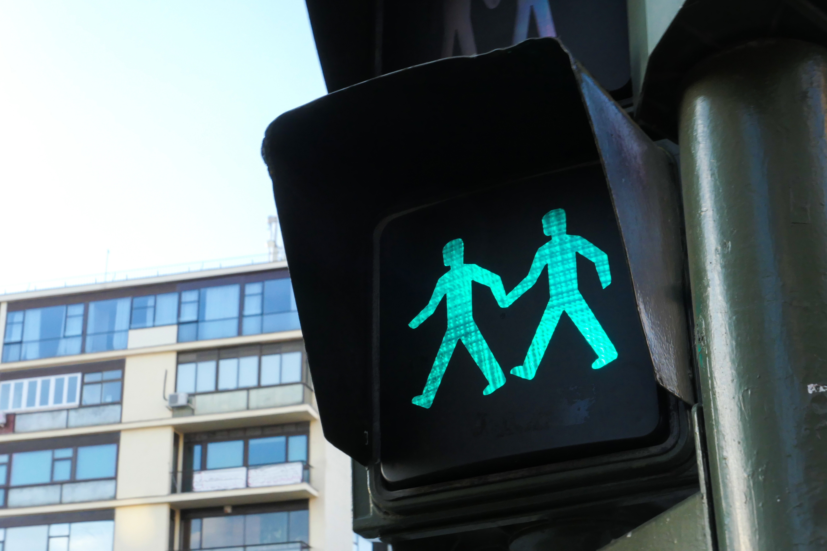
Boundary interventions
Explore what consent means to the client.
Establish a “stop sign” for therapy.
Practice mindfulness to help the client identify when they are outside their window of tolerance.
Create a physical boundary.
“We are not taking away anything you need”
May include re-framing of responsibility

Slide 41

Connection to the Body
Trauma survivors often experience disruption in body connection.
Hyper-arousal may result is “flooding”
Hypo-arousal may result in dissociation.
“Gut instincts are guardian angels.”
We cannot process information we cannot tolerate or do not have access to.

Slide 42
“The single most important issue for traumatized people is to find a sense of safety in their own bodies.”
Bessel Van Der Kolk

Slide 43
Interventions to connect to the body (and increase affect tolerance)
Often must begin with an “island of safety” or tolerance for positive or neutral sensation that can be resourced. (Laurel Parnell’s Tapping In)
Sensory exercises
  Sensory checklist—increasing vocabulary and neutral feelings/sensations
  Levine shower exercise
Nurturing touch (Neff)
Body scan and/or mindfulness work
  No Mud No Lotus
  MSC Workbook
Trauma-informed Yoga
Somatic therapies
Often will require titration or pendulation to maintain window of tolerance

Slide 44
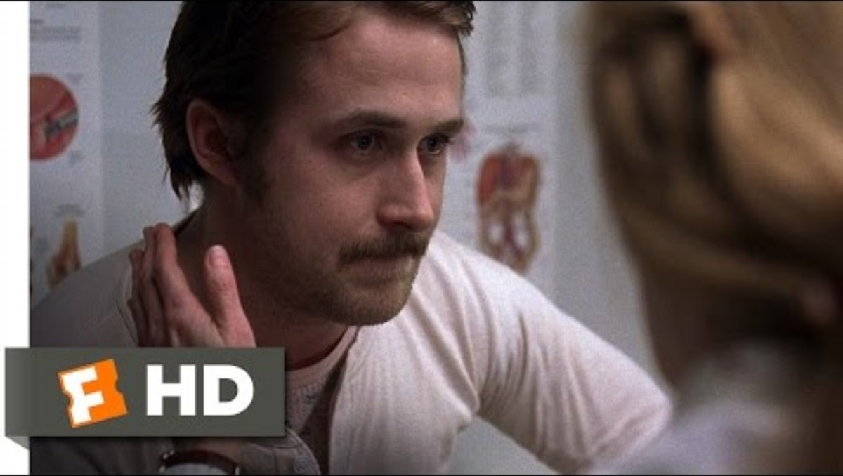

Slide 45
Self-Compassion Work
Compassion is directly opposed to shame or judgement
3 components of Compassion (Kristin Neff, www.self-compassion.org)
  Mindful acknowledgement over minimizing or overidentifying
  Shared human experience over isolation
  Kindness over judgement
The 3 components can also be followed up by a boundary if necessary.
Compassion is NOT pity. Pity isolates and compassion connects.
Self-compassion work is often paired with parts work to repair internal systems. It is modeled by the therapist.

Slide 46
Parts work
Through the lens of Internal Family Systems (IFS) we all have parts.
  Protectors (Managers and Firefighters)
  Exiles
Protectors are often the “gatekeepers” to traumatic material. We (the therapist and client) must earn the trust of protective parts in order to access traumatic material.
Exiles (or wounded parts) are often stuck in “trauma time” and store/hold trauma memories and “burdens”.
During stage one of therapy, we aim to establish trust with parts of self.
During stage two we aim to unblend and unburden the parts.
The ultimate goal is Self-Leadership.
Parts work is woven throughout all stages of therapy.

Slide 47
Qualities of Self Leadership: 8 C’s of and the 5 P’s of IFS
Compassion
Creativity
Curiosity
Connected
Confidence
Calm
Clarity
Courage
Patience
Presence
Persistence
Perspective
Playfulness

Slide 48


Slide 49
Aligning with Protective Parts
Protective parts may repeat abusive messages internally.
Practice curiosity and compassion (and all Cs!) with protectors.
  What is the protector’s job?
  Explore the protector’s positive intention (PPI)? Be curious.
  What does the protector need? Practice acknowledging this with “I get that”.
  Work to reduce the shame of the protective part by extending compassion/self-compassion.
  Work to align with the protective part by acknowledging their important role in survival and a common PPI.
  Change the “job description”.

Slide 50
Working with dependent parts (child parts)
The most important concept in working with child parts is to ensure these parts remain the responsibility of the client. The adult self must become responsible for all parts.
The therapist is not the primary caregiver and is not responsible for re-parenting.
Clients with high dependency needs often will project needs onto the therapist.
Child parts are often dislike or reviled by other parts as they often represent what the client desires to avoid.
Child parts may serve to hold memory, avoid responsibility, preserve ideal view of parents or perpetrators, express dependency needs, hold intense emotions.

Slide 51
Other concepts
Some parts may act in ways that are not safe or socially acceptable. Examples may include over-sexualized parts or perpetrator-imitating parts.
  We must be curious while also setting limits.
We aim to understand each part and their role in survival. We are not aiming to get rid of any part.
Conflict between parts may signal internal reenactment.
If parts hold intense emotions our work may include helping the client express these verbally (rather than physically acting out), in appropriately contained ways, so they can be heard by others.

Slide 52
Working with anger
Anger is experienced physiologically as a part of “unfreezing”.
  In an unspoken voice, Levine
Anger is an appropriate response to injustice and often represents an important shift in responsibility. It is a bridge from shame to self-compassion.
Anger is a stage of grief. Anger and grief often go hand-in-hand.
If an individual has learned anger is wrong or unsafe there is a temptation to refreeze.
Working through anger (and grief) is often woven throughout of all stages of therapy.

Slide 53
Secondary Gains
Ana Gomez Coat Metaphor
Change is HARD and feels very RISKY.
  It may require we sacrifice the benefits of staying stuck.
  APCC Example- “K”
The Healing Crisis
  i.e. in “unfreezing” and individual may feel the “energy” of fight/flight which can be expressed as rage.
  The experience of trauma-related grief

Slide 54
STAGE TWO

Slide 55

Stage Two Goals and Objectives:
The goal of stage two is to process and desensitize traumatic material.
But what does it mean to “process”?

Slide 56
Processing Traumatic Material
Separate past from present cognitively and somatically—what was true then is not true now.
Reframe unhealthy beliefs about the self regarding the traumatic experience.
Move toward Self-Leadership, continuing to foster connection between all parts of self.

Slide 57
Stage two interventions
Stage two may include a number of evidence-based therapies to process traumatic information. Including but not limited to:
EMDR, ART, Brainspotting
Somatic therapies
Exposure therapy
Narrative therapy
TF-CBT
IFS
What are your favorite therapeutic interventions to process trauma?

Slide 58
Readiness factors for trauma processing; things to consider
Ability to be aware of one’s own experience—Mindfulness
Containment and state change
Connection to the body and dissociation
Prescence of blocking beliefs
Self-compassion
Secondary gains
Window of tolerance—can the client tolerate traumatic material?

Slide 59
Helpful interweaves for trauma processing
Redirection to the body to nurture; or “what would your body like to do?”
Benefit question
How do you feel about (or toward) the part of you that survived this?
  For EMDR, follow up with desensitizing LUP or resourcing POS (Bruce Hersey).
“Are you aware (or is this part of you aware) that it is over and you survived?”
“Through the eyes” (Sandra Paulsen); Grounding
Self-compassion (Neff)
“We are not taking away anything you need OR You will not lose anything you need”. (Roger Solomon)
“Imagine that” (Laurell Parnell)
Compassionate truthteller/Allies
Taxing the Working Memory
Offering psychoeducation

Slide 60

Where do you feel stuck in processing with clients?

Slide 61
Stage Three

Slide 62
Stage three goals and objectives:
Process post traumatic grief
Practice new boundaries and behaviors
Establish meaning and act according to values that are important to the survivor.
Establish and maintain healthy relationships

Slide 63
Trauma Related Grief
Grief does not always include trauma, but trauma ALWAYS involves grief.
Grief is the experience of loss.
Grief is a universal experience. It cannot be fixed. It must be experienced.
Trauma-related grief cannot be addressed until there is a distinction between past and present. This may delay the process of grieving in the case of Trauma.
Example: The desire for a “re-do” is a barrier to living in the present and delays grief. This leads to possible re-traumatization.

Slide 64
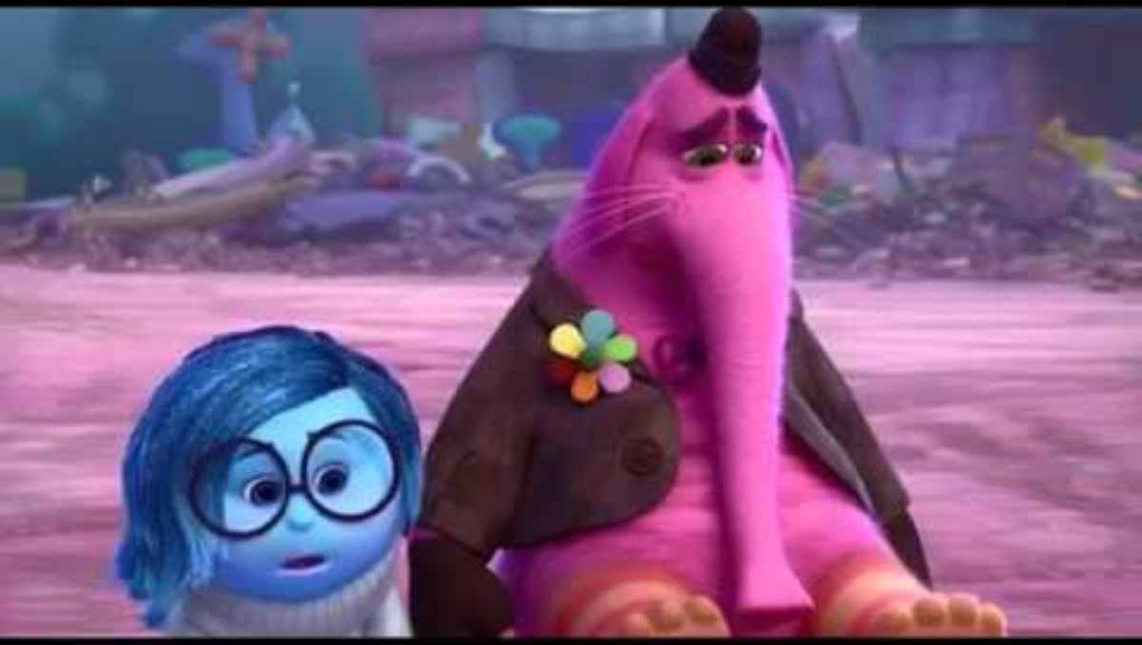

Slide 65
The difficult practice of new boundaries and behaviors
Honoring innate wisdom from the body now that the body is safe.
Action where the client might have frozen before
Action according to new information, resources, and power.
May still feel innately risky and require support.
Like physical therapy after a surgery, clients must learn how to apply new skills and resources. This often requires ongoing therapeutic support.

Slide 66
Improving Relational Health
CPTS survivors may not have a template for healthy relationship (this is partly why the therapeutic relationship is so important).
Secure attachment may feel “boring.”
Shared responsibility in relationship may feel dangerous to the client who survived through fight/flight or distant and uncaring to the client who survived through freeze.
Improving relational health will include psychoeducation, increasing tolerance, and skills practice.

Slide 67

Value work
Identifying/Knowing our values can motivate meaningful action and positively influence affect tolerance.
ACT therapy identifies four categories of values:
  Relationship
  Work
  Leisure or recreation
  Health

Slide 68
Strategies to create meaning
We create meaning when we connect to our “Something Bigger” (transcendence).
In their book Burnout, Nagoski and Nagoski identify 3 strategies to foster meaning:
Pursuit and achievement of ambitious goals that leave a legacy
Service to the divine or other spiritual calling
Loving, emotionally intimate connection with others

Slide 69
Transgenerational Healing
Healing from complex trauma may create distance with the family of origin, bringing additional grief.
In order to continue growth, the client must identify new boundaries and behaviors in existing systems that may or may not be on the same trajectory of healing.
Concepts of transgenerational healing, though difficult, can increase sense of meaning and purpose and be encouraging to clients.

Slide 70


Slide 71
Final Thoughts
Working with complex cases is difficult and therapists may be vulnerable to burnout.
Pay attention to your own experience and seek consultation regularly.
3 areas of experience to pay attention to:
  Spirituality
  Responsibility
  Grief
It is unfair to ask our clients to do work we are not willing to do ourselves.

Slide 72
“Somewhere between internalizing the ethic of martyrdom and ignoring ongoing crisis lies the balance we must find in order to sustain our work.”
Van dernoot Lipsky and Burk, 2009

Slide 73
Thank you!
Elizabeth Clark, MA, LPC-S
Amarillo Professional Counseling and Consultation
www.Amarillo-counseling.com
Elizabethclark@amarillo-counseling.com

Slide 74
References
Baldwin, J. (2018). Trauma-sensitive theology. Eugene, OR. Cascade books.
Brown, B. (2018). Dare to lead. New York: Random House.
Brown, B. (2017). Rising Strong. New York: Random House.
Harvard University Center on the Developing Child. www. Developingchild.Harvard.edu.
Levine, P.A. (2010). In an unspoken voice. North Atlantic Books.
Levine, P.A. & Kline, M. (2008). Trauma –Proofing Your Kids. North Atlantic Books.
Nagoski, E. (2021). Come as you are: Revised and Updated. Simon & Schuster.
Nagoski, E. & Nagoski, A. (2019). Burnout; The secret to unlocking the stress cycle. New York: Ballatine Books.
Ogden, P., Minton, K., & Pain, C. (2006). Trauma and the body: A sensorimotor approach to psychotherapy. New York: W. W. Norton & Company.
Perry, B. D. & Szalavitz, M. (2007). The boy who was raised as a dog and other stories from a child psychiatrist’s notebook. New York: Basic Books.

Slide 75
References Continued
Perry, B. D. & Winfrey, O. (2021). What happened to you? Conversations on trauma, resilience, and healing. Flatiron Books.
Schwartz, A. (2017). The complex trauma workbook: A mind-body approach to regaining emotional control & becoming whole. Althea Press.
Schwartz, A. (2021). The complex PTSD treatment manual: An integrative, mind-body approach to trauma recovery. PESI.
Schwartz. R. C. (2021). No bad parts: Healing trauma & restoring wholeness with the internal family systems model. Boulder, CO: Sounds true.
Steele, K., Boone, S., & Van Der Hart, O. (2017). Treating trauma related dissociation: A practical, integrative approach. New York: Norton & Company.
Van der Kolk, B. A. (2016). The body keeps the score: Brain, mind, and body in the healing of trauma. New York: Penguin Books.
Van Dernoot Lipsky, L. & Burk, C. (2009). Trauma Stewardship: and everyday guide to caring for self while caring for others. Oakland, California. Berrett-Koehler

